Slide 1
Operating system
Part VII: Deadlock [死锁]
By KONG LingBo (孔令波)

Slide 2
Goals
Know the concepts of deadlock
Four necessary conditions
Know the strategies to overcome the deadlock situation
Staying Safe
Preventing Deadlocks
Avoiding Deadlocks
Living Dangerously
Let the deadlock happen, then detect it and recover from it.

Slide 3
Device management
Deadlock
Definition, Model
Methods for Handling Deadlocks
Providing enough resources
Staying Safe
Preventing Deadlocks
Avoiding Deadlocks
Living Dangerously
Let the deadlock happen, then detect it and recover from it.
Ignore the risks

Slide 4


However, it also will cause some problems if ….
If there is no controlled access to shared data, execution of the processes on these data can interleave⬅ Cooperation.
The results will then depend on the order in which data were modified→ Data Inconsistency
i.e. the results are non-deterministic.
Concurrent processes (or threads) often need to share data (maintained either in shared memory or files) and resources
If there is no proper policy to assign resources among processes, it may result in that all the processes get blocked → Deadlock [死锁]
We have discussed this by synchronization
PPTs from others\flame.cs.dal.ca_~hawkey_3120\May21ProcessSynchronization.ppt

Slide 5
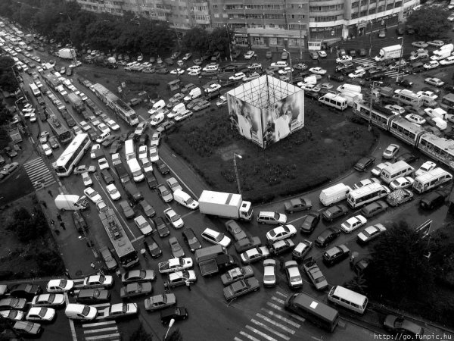
http://www.vijayforvictory.com/tag/pictures/

Slide 6
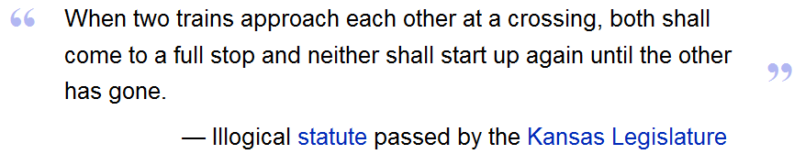
Deadlock: General
From Wikipedia, the free encyclopedia
A deadlock is a situation wherein two or more competing actions are waiting for the other to finish, and thus neither ever does.
It is often seen in a paradox like the "chicken or the egg."

Slide 7
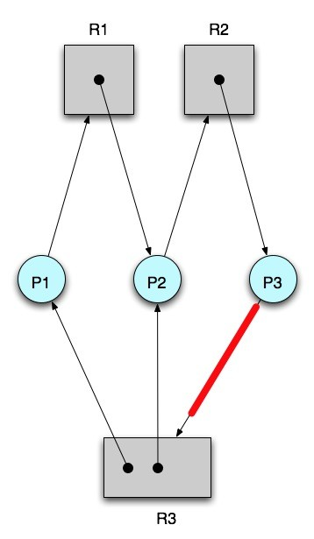
Deadlock in OS
A set of blocked processes each holding some resources and waiting to acquire a resource held by another process in the set.
None of the processes can proceed or back-off (release resources it owns)

Slide 8
Resource-Allocation Graph (Cont.)
Process
Resource Type with 4 instances
P_{i} requests instance of R_{j}
P_{i} is holding an instance of R_{j}
P_{i}
R_{j}
P_{i}
R_{j}
PPTs from others\Operating System Concepts 6ed\Slides\ch8.ppt

Slide 9
It seems … [Basic Facts, Theorem]
If there are enough materials for everyone, no deadlock at all!
When a deadlock occurs, four conditions must have been reached at the same time!
Mutual Exclusion [互斥]
At least one resource is non-sharable: at most one process at a time can use it
Hold-and-Wait [占有并等待]
At least one process is holding one resource while waiting to acquire others, that are being held by other processes

Slide 10
Deadlock can arise only if …
We have a deadlock if every process P_{i} is waiting for a resource instance that is being held by another process
A deadlock can arise only if all four conditions hold
Mutual Exclusion [互斥]
At least one resource is non-sharable: at most one process at a time can use it
Hold-and-Wait [占有并等待]
At least one process is holding one resource while waiting to acquire others, that are being held by other processes
Notes:
充分条件, sufficient condition.
必要条件, necessary condition.
充要条件, sufficient and necessary condition

Slide 11
Deadlock can arise only if …
A deadlock can arise only if all four conditions hold
No preemption [非抢占]
A resource cannot be preempted (a process needs to give it up voluntarily)
Circular Wait [循环等待]
There exists a set {P₀, P₁, …, P_{n}} of waiting processes such that
P_{i} is waiting for a resource that is held by P_{i+1}, 0 ≤ i < n
P_{n} is waiting for a resource that is held by P₀

Slide 12
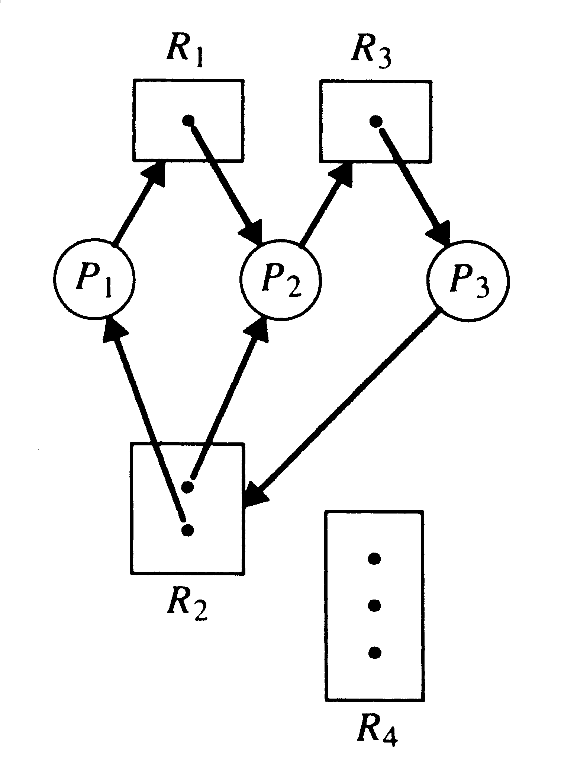

Deadlock
Because you cannot find an execution sequence of the all three processes so that each of them can finishes its work finally.
PPTs from others\www.dcs.ed.ac.uk_teaching_cs3_osslidesdeadlock.ppt

Slide 13
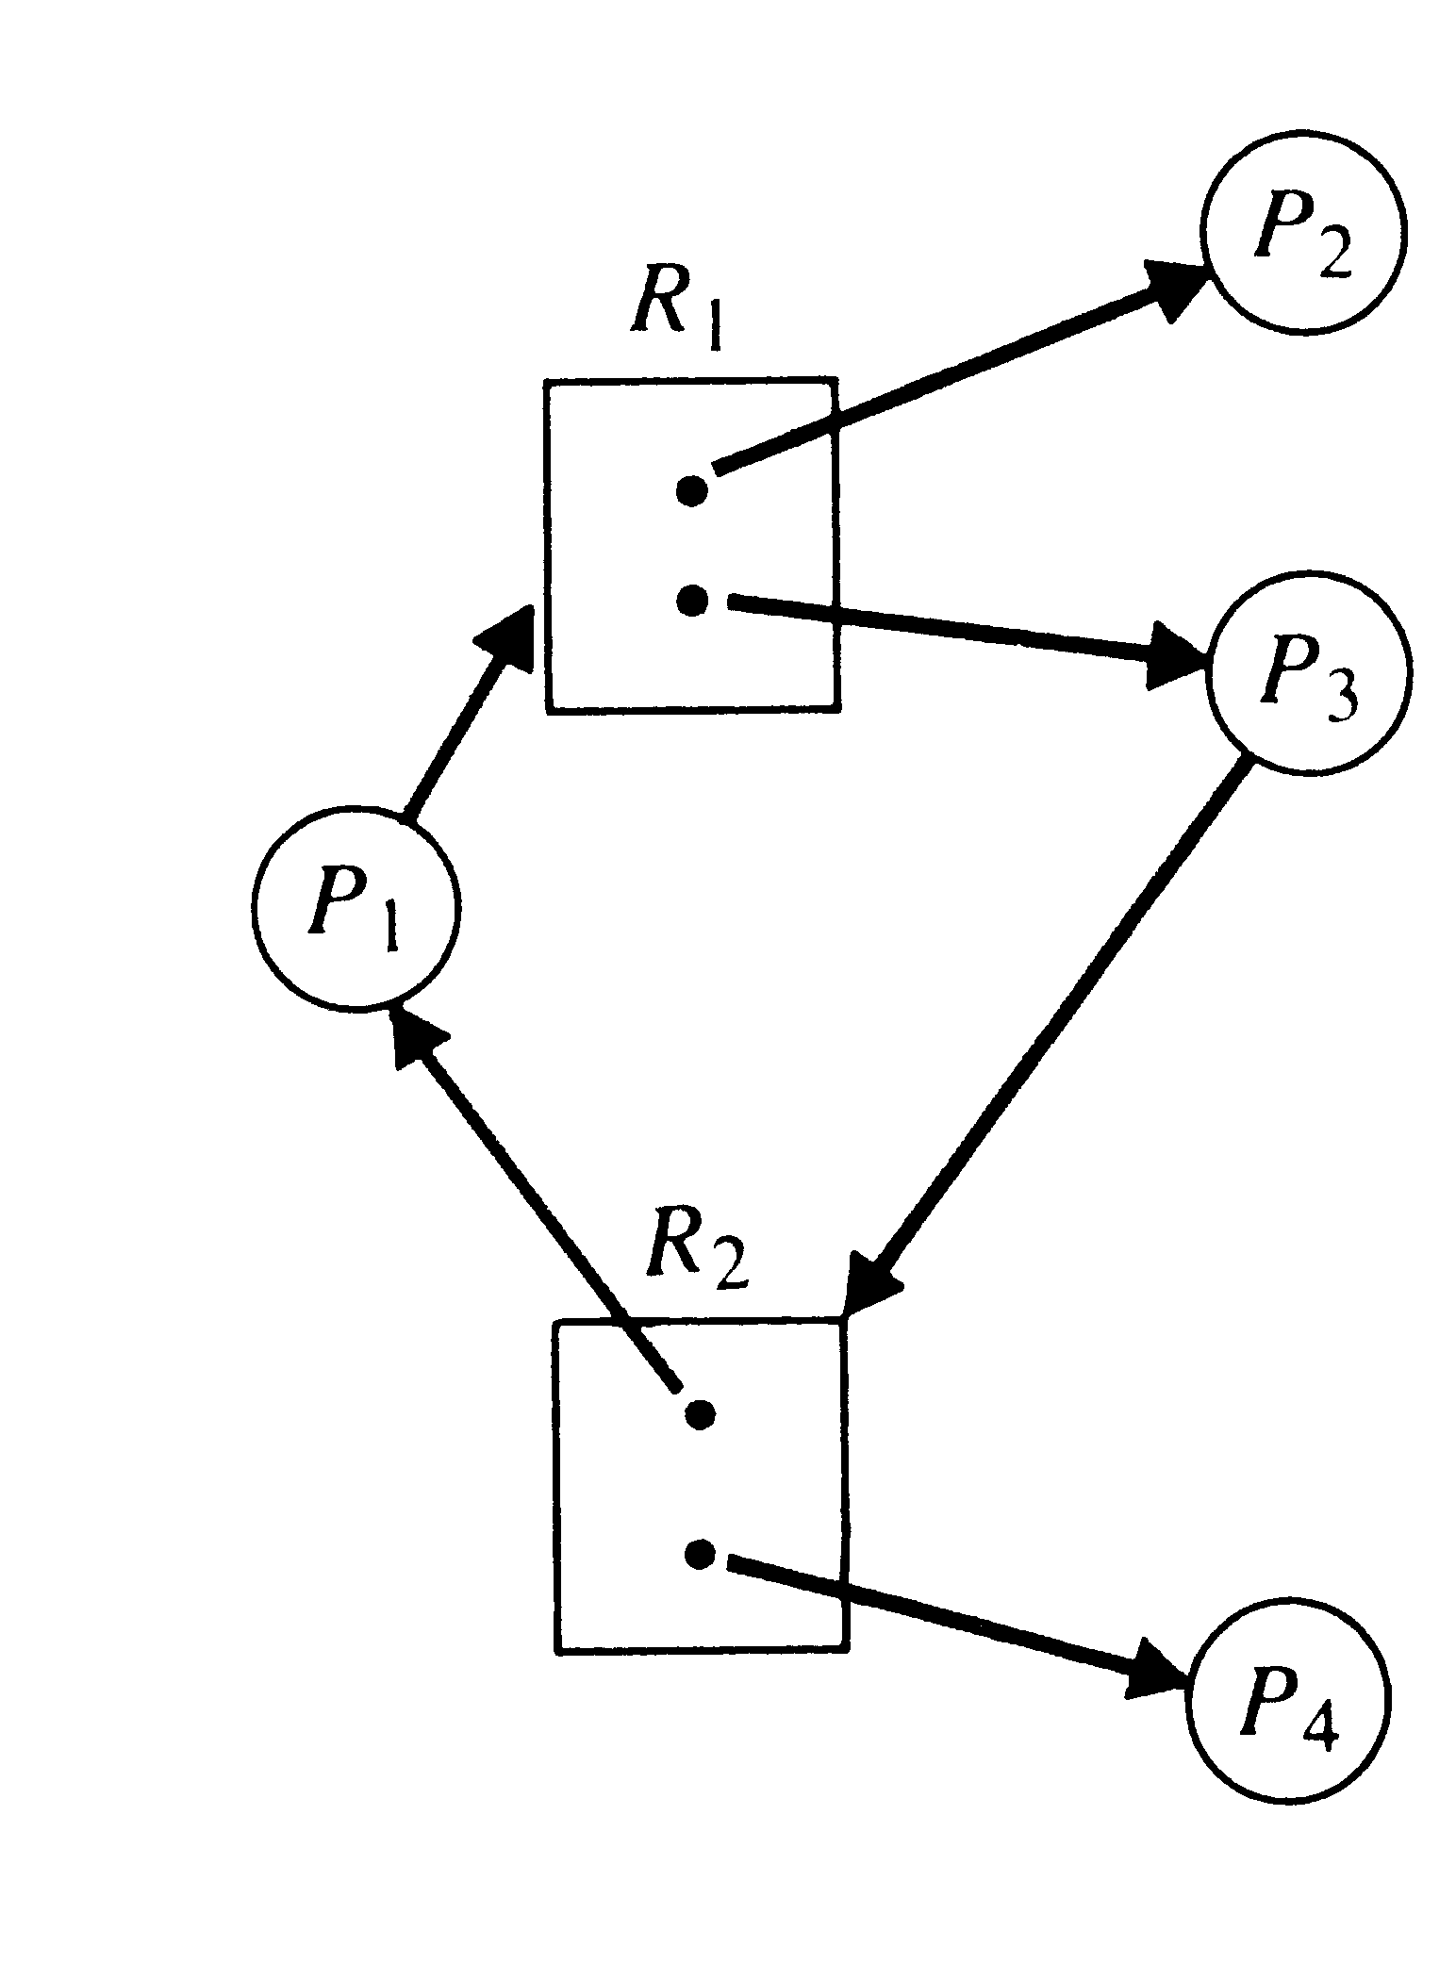

A cycle not sufficient to imply a deadlock:
Because there is a path of resource allocation to satisfy all the requirements
PPTs from others\www.dcs.ed.ac.uk_teaching_cs3_osslidesdeadlock.ppt

Slide 14
It seems …
If the graph contains no cycles, then no process is deadlocked.
If there is a cycle, then two situations:
If resource types have multiple instances, then deadlock MAY exist.
If each resource type has 1 instance, then deadlock has occurred.
The existence of a cycle is a sufficient and necessary condition for the existence of a deadlock
Each process involved in the cycle is deadlocked

Slide 15
Device management
Deadlock
Definition, Model
Methods for Handling Deadlocks
Providing enough resources
Staying Safe
Preventing Deadlocks
Avoiding Deadlocks
Living Dangerously
Let the deadlock happen, then detect it and recover from it.
Ignore the risks

Slide 16
Providing enough resources - A useful equation!
Given:
Here are 3 processes: A, B, C. Each of them requires 5 system resources.
Question:
How many resources should the system at least have so that the system is safe?
Rule:
If the number of system resources satisfies the following equation, then the system is safe!
Notes:
Combinatorics [ˌkɔmbineiˈtɔriks] n. [pl.][用作单]组合数学

Slide 17
A useful equation!
P_{max}: is the max number of the required resources by process P
R_{total}: is the total resources the system has
It could be simplified as follows, where N is the number of processes
Notes:
例题1：系统有3个进程：A、B、C。这3个进程都需要5个系统资源。如果系统有多少个资源，则不可能发生死锁。
在分析这个问题时，我们可以取一些简单的数据代入试题进行验证、分析，以得到相应的规律。
一个规律：先给所有进程分配他们所需要的资源数减 1 个资源，然后系统如果能再剩余1个资源，则系统不会发生死锁。

Slide 18
It is easy to answer the given question:
According to the above equation
N is 3
P_{max} is 5
So, there should be at least (5-1)*3+1 = 13 resources in the system, then the system is in safe!
Notes:
[2012-10-15]
我原本对此公式的道理没怎么思考过, 2012-10-12日上课期间, 再次提到这个问题, 一个学生为我解惑 – 张政元(12126057). 其逻辑需要组合数学的理论, 尤其是其中的Ramsey/抽屉理论. 在于:
(P_{max} – 1)表示进程只差一个资源, 那么(P_{max} – 1)*N 就表示每个进程都只差一个资源时的资源总数, 那么, (P_{max} – 1)*N +1 就表示极限情况下只要再多一个资源就可以满足全部进程的需求. 所以, 最少所需资源数就是那个限制.

Slide 19
Variations
Question:
A system has 10 tape drivers, which are shared by m processes, and each process requires 3 tape drivers at most. So, what should “m” be then the system could be in safe?
A.3 B.4 C.5 D.6
By that equation, we have
(3-1)*m+1 <= 10
So, m <= 4.5
B is the answer
Notes:
例题2：一台计算机有10台磁带机被m个进程竞争，每个进程最多需要三台磁带机，那么m至多为 时，系统没有死锁的危险。
A.3 B.4 C.5 D.6

Slide 20

Ignore - the Ostrich[鸵鸟] or Head-in-the-Sand algorithm
Most Operating systems do this!!
D.J.[ˈɔstritʃ]
Of course, Try to reduce chance of deadlock as far as reasonable
And, accept that deadlocks will occur occasionally
example: kernel table sizes - max number of pages, open files etc.
Because, maybe
MTBF versus deadlock probability ?
cost of any other strategy may be too high
overheads and efficiency
MTBF : mean-time between "failures"
PPTs from others\www.dcs.ed.ac.uk_teaching_cs3_osslides\deadlock.ppt

Slide 21

Maybe it’s better — “Don’t hide from the fact…, Be alert!”

Slide 22
Deadlock Prevention (预防)
Do not allow one of the four conditions to occur.
Mutual Exclusion [互斥]
Only one process may use a resource at a time
Hold and Wait [持有和等待]
A process may hold allocated resources while awaiting assignment of others
No Preemption [非抢占]
No resource can be forcibly removed form a process holding it
Circular Wait [循环等待]
A closed chain of processes exists, such that each process holds at least one resource needed by the next process in the chain
PPTs from others\SCU_Zhaohui\OS\Chapter06.ppt

Slide 23
Deadlock Prevention - negating Hold and Wait
Two strategies
When the process begins, all the resources required by it should be assigned to it
inefficient - not all resources needed all the time
processes probably will not know in advance what resources they will need
may have to wait excessive time to get all resources at once - starvation
high priority processes may cause starvation of low priority processes

Slide 24
Two strategies
When a new request is needed by a processes
it could release existing resources it holds if it fails to get a new resource immediately (try again later)
the process always releases its existing resources and asks for all of them at once

Slide 25
Deadlock Prevention - negating Circular Wait
Ordered resource allocation [资源顺序分配法]
Quite popular in management science (such as MBA)
Steps:
Assign each resource class with a unique number
The process should apply for all its required m-class resources following the order of resource class numbers
r₁, r₂, …, r_{i}
↓ ↓ ↓
1 2 i
F(r_{i}) = i
Notes:
反证法的英文
Proof by contradiction; reduction to absurdity; reductio ad absurdum
Logical principles of disproved method and use of disproved method in the theory of diagrams
反证法的逻辑原理及其在图论中的应用
Abstract : reduction to absurdity is an important mathematical proof , and its analysis , synthesis , has a long history , applications are very wide
摘要:反证法是一种重要的数学证明方法，它和分析法、综合法一样，有着悠久的历史，应用也相当广泛。

Slide 26
This implies … request has been known. You’ve to propose your request at the beginning
Since all the resources lower must have been achieved before the process requires the resources in higher order, there should not be cycle!
P₀
r₀
r₁
P_{n}
…
NO WAY!
r_{n}
Notes:
[2012-10-15]
资源的分配是宏观管控的: 当有新进程时, 其资源总需求是预先确定的 – 只是申请次序不定. 那么, 在将资源排序后, 任一进程申请资源R_{i}时, 分配程序都会检查该进程是否还有低于R_{i}等级的资源还没有得到分配. 如果没有, 那么, 分配程序将尝试着将R_{i}分配给该进程; 否则, 不分配R_{i}给该进程. 这样就避免了循环等待, 也就打破了造成死锁的四个表要条件之一.
通过上面的叙述, 也可以清楚地看出该算法的缺陷, 即, 分配程序需要预先知道所有进程的资源请求. 显然, 这是理想的 – 也就意味着实际中难以实现.

Slide 27
Deadlock Avoidance (避免)
Deadlock prevention → low device utilization and reduced system throughput.
Deadlock avoidance
Given the complete sequence of requests and releases for each process, we can decide for each request whether or not the process should wait.
For every request, the system
considers the resources currently available, the resources currently allocated, and the future (Needed) requests and releases of each process, and
decides whether the current request can be satisfied or must wait to avoid a possible future deadlock.
PPTs from others\OS PPT in English\ch08.ppt

Slide 28
Example 2:
5 processes P₀ through P₄;
3 resource types:
A (10 instances), B (5instances), and C (7 instances)
Snapshot at time T₀:
Allocation Max Available
A B C A B C A B C
P₀ 0 1 0 7 5 3 3 3 2
P₁ 2 0 0 3 2 2
P₂ 3 0 2 9 0 2
P₃ 2 1 1 2 2 2
P₄ 0 0 2 4 3 3

Slide 29
Example 2 (cont’)
We can compute the matrix Need as Max – Allocation
Need
A B C
P₀ 7 4 3
P₁ 1 2 2
P₂ 6 0 0
P₃ 0 1 1
P₄ 4 3 1
Available
A B C
3 3 2
SAFE or not is determined by if we could find a sequence!

Slide 30
Example 2 (cont’)
P3
Compare the available resources and the needed resources for each process to find if there is some process whose requirement could be satisfied.
P1 1 2 2
P3 0 1 1
Randomly select one, here we select P3
The available now is
<3, 3, 2> + <2,1,1> ➔ <5, 4, 3>
Need
A B C
P0 7 4 3
P1 1 2 2
P2 6 0 0
P3 0 1 1
P4 4 3 1
Need
A B C
P0 7 4 3
P1 1 2 2
P2 6 0 0
P3 0 0 0
P4 4 3 1
Available
A B C
3 3 2
Available
A B C
5 4 3
Allocation
P3 2 1 1

Slide 31
Example 2 (cont’)
P3
P1
Similarly, there are two processes whose requirements could be satisfied.
P1 1 2 2
P4 4 3 1
Randomly select one, here we select P1
The available now is
<5, 4, 3> + <2,0,0> ➔ <7, 4, 3>
Need
A B C
P0 7 4 3
P1 0 0 0
P2 6 0 0
P3 0 0 0
P4 4 3 1
Need
A B C
P0 7 4 3
P1 1 2 2
P2 6 0 0
P3 0 0 0
P4 4 3 1
Allocation
P1 2 0 0
Available
A B C
7 4 3
Available
A B C
5 4 3

Slide 32
Example 2 (cont’)
P3
P1
P0
P2
P4
Similarly, there are three processes whose requirements could be satisfied.
P0 7 4 3
P2 6 0 0
P4 4 3 1
We can directly infer that all those processes could be finished!
P0 ➔ P2 ➔ P4
Need
A B C
P0 7 4 3
P1 0 0 0
P2 6 0 0
P3 0 0 0
P4 4 3 1
So, system is safe at the snapshot time t0!
Available
A B C
7 4 3

Slide 33
Example 2:
How about the snapshot as follows?
Allocation
A B C
P0 0 1 0
P1 2 0 0
P2 3 0 2
P3 2 1 1
P4 0 0 2
Need
A B C
P0 7 4 3
P1 1 2 2
P2 6 0 0
P3 0 1 1
P4 4 3 1
Available
A B C
1 1 1

Slide 34
Example 2 (cont’)
P3
Compare the available resources and the needed resources for each process to find if there is some process whose requirement could be satisfied.
P3 0 1 1
So we select P3
The available now is
<1, 1, 1> + <2,1,1> ➔ <3, 2, 2>
Need
A B C
P0 7 4 3
P1 1 2 2
P2 6 0 0
P3 0 1 1
P4 4 3 1
Need
A B C
P0 7 4 3
P1 1 2 2
P2 6 0 0
P3 0 0 0
P4 4 3 1
Allocation
P3 2 1 1
Available
A B C
1 1 1
Available
A B C
3 2 2

Slide 35
Example 2 (cont’)
P3
P1
Need
A B C
P0 7 4 3
P1 1 2 2
P2 6 0 0
P3 0 0 0
P4 4 3 1
Need
A B C
P0 7 4 3
P1 1 2 2
P2 6 0 0
P3 0 0 0
P4 4 3 1
Similarly, we can see P1 could be satisfied.
P1 1 2 2
So we select P1
The available now is
<3, 2, 2> + <2,0,0> ➔ <5, 2, 2>
Allocation
P1 2 0 0
Available
A B C
3 2 2
Available
A B C
5 2 2

Slide 36
Example 2 (cont’)
P3
P1
Need
A B C
P0 7 4 3
P1 0 0 0
P2 6 0 0
P3 0 0 0
P4 4 3 1
After P1, available res is <5, 2, 2>
Sadly, this time, the rest three processes could not be satisfied <5, 2, 2>.
P0 7 4 3
P2 6 0 0
P4 4 3 1
This means it is not safe for the snapshot of example 2!
Available
A B C
5 2 2

Slide 37
Example 3:
5 processes P₀ through P₄;
3 resource types:
A (10 instances), B (5instances), and C (7 instances)
Snapshot at time T₀:
Allocation Max Available
A B C A B C A B C
P₀ 0 1 0 7 5 3 3 3 2
P₁ 2 0 0 3 2 2
P₂ 3 0 2 9 0 2
P₃ 2 1 1 2 2 2
P₄ 0 0 2 4 3 3
Could the request of P0=<2 1 1> be satisfied or not?

Slide 38
The logic for that satisfaction is
Pretend to satisfy the request first, and check if the change will lead the system into unsafe state or not
Still safe, the request could be satisfied
We need update the resource allocation first – the available and the needed for P0
Needed
A B C
5 3 2
1 2 2
6 0 0
0 1 1
4 3 1
Allocation
A B C
P0 2 2 1
P1 2 0 0
P2 3 0 2
P3 2 1 1
P4 0 0 2
Available
A B C
1 2 1
You’ve learned how to verify if the system is safe or not from Example 1

Slide 39
Drawbacks of Banker’s Algorithm
processes are rarely known in advance how many resources they will need
the number of processes changes as time progresses
resources once available can disappear
the algorithm assumes processes will return their resources within a reasonable time
processes may only get their resources after an arbitrarily long delay
practical use is therefore rare!

Slide 40
Detection & Recovery
Check for deadlock (periodically or sporadically[偶发地,零星地]), then recover
Differentiate between
Serially reusable resources: A unit must be allocated before being released
Consumable resources: Never release acquired resources; resource count is the number currently available
PPTs from others\cms.dt.uh.edu\chap10.ppt

Slide 41
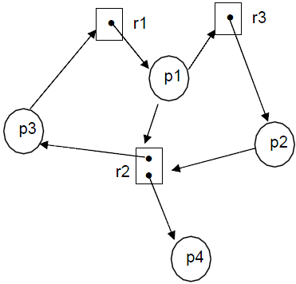
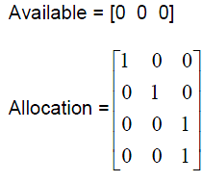
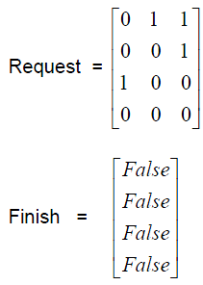
Borrow Banker’s algorithm for several instances
Find if there is a sequence of the involved processes to finish
If all the values in Finish vector are TRUE or not

Slide 42
Recovery
Two strategies
Process Termination
Abort all deadlocked processes.
Abort one process at a time until the deadlock cycle is eliminated.
In which order should we choose to abort?
Priority of the process.
How long process has computed, and how much longer to completion.
Resources the process has used.
Resources process needs to complete.
How many processes will need to be terminated.
Is process interactive or batch?
PPTs from others\OS PPT in English\ch08.ppt

Slide 43
Recovery
Two strategies
Resource Preemption
Choose a blocked process
Preempt it (releasing its resources)
Back up each deadlocked process to some previously defined checkpoint
Run the detection algorithm
Iterate it until the state is not a deadlock state
Selection Criteria Deadlocked Processes
Least amount of processor time consumed so far
Least number of lines of output produced so far
Most estimated time remaining
Least total resources allocated so far
Lowest priority
PPTs from others\OS PPT in English\ch08.ppt

Slide 44
Combined Approach to Deadlock Handling
Combine the three basic approaches (prevention, avoidance, and detection), allowing the use of the optimal approach for each class of resources in the system.
Partition resources into hierarchically ordered classes； Use most appropriate technique for handling deadlocks within each class.
An example:
Internal resources (Prevention through resource ordering)
Central memory (Prevention through preemption)
Job resources (Avoidance)
Swappable space (Pre-allocation)
PPTs from others\OS PPT in English\ch08.ppt

Slide 45
In conclusion
Deadlock is a situation wherein two or more competing actions are waiting for the other to finish, and thus neither ever does.
Four necessary conditions
Mutual Exclusion [互斥]
Hold-and-Wait [占有并等待]
No preemption [非抢占]
Circular Wait [循环等待]
Strategies to overcome the deadlock situation
Staying Safe
Preventing Deadlocks
Avoiding Deadlocks → Banker’s algorithm!
Living Dangerously
Let the deadlock happen, then detect it and recover from it.

